Slide 1
Start MySQL Server on Linux
On Linux, you can start the server with the following commands using service, init.d, and systemd.
Start MySQL Server using service
sudo service mysql start
Start MySQL Server using using init.d
sudo /etc/init.d/mysql start
Start MySQL Server using systemd
sudo systemctl start mysqld

Slide 2
Start MySQL Server on Windows
On Windows, you can start the MySQL Server using the mysqld program as follows:
First, open the Run dialog by pressing Windows+R keyboards:
Second, type cmd and press Enter:
Third, type mysqld and press Enter:
mysqld
If the bin folder is not in the Windows path environment, you can navigate to the bin folder e.g., C:\Program Files\MySQL\MySQL Server 8.0\bin\ and use the mysqld command.

Slide 3
Stop MySQL Server
On Windows, you can stop MySQL Server using the program mysqladmin.
The program mysqladmin locates in the folder <path_to_installation_dir>\bin, where path_to_installation_dir is the path to the installation directory e.g., C:\Program Files\MySQL\MySQL Server 8.0\
Typically, you should add the pathname of the MySQL bin directory to Windows path environment variable to access any MySQL programs in the bin directory faster.

Slide 4
To stop MySQL, you follow these steps:
First, launch the Command Prompt by pressing Windows+R to open the Run box and type cmd and press Enter.
Second, navigate to the bin folder of the MySQL if it is not in the Window path environment.
Third, use the following command to stop MySQL Server:
mysqladmin -u root -p shutdown
Enter password: ********
It prompts for a password of the root account. You need to enter the password and press the Enter keyboard.
The program will stop the MySQL Server.

Slide 5
Stop MySQL Server on Linux
To stop MySQL Server on Linux, you use the following command:
/etc/init.d/mysqld stop
Some Linux distributions provide server command:
service mysqld stop
Or
service mysql stop

Slide 6
Restart MySQL Server
Restart MySQL Server on Windows
If MySQL installed as a Window service, you follow these steps to restart the MySQL Server:
First, open the Run window by using the Windows+R keyboard.
Second, type services.msc and press Enter:

Slide 7
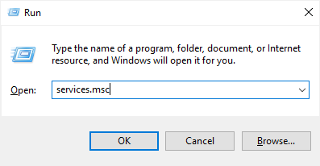

Slide 8
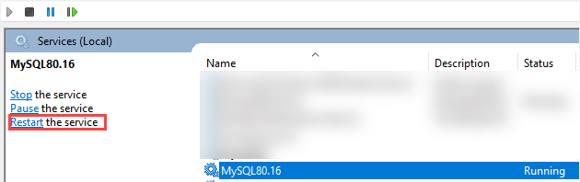
Third, select the MySQL service and click the restart button.

Slide 9
Restart MySQL Server on Linux
You use the following command to restart the MySQL server On Linux:
service mysql restart
If the name is MySQL service is mysqld not mysql, you need to change the service name in the command as shown in the following command:
service mysqld restart
Or you can use the init.d to start the MySQL service:
/etc/init.d/mysqld restart

Slide 10
Thank You
Please Subscribe My Channel
https://www.youtube.com/channel/UCYW3PWPOPn3qgxxjhUbXXXg?view_as=subscriber

